Slide 1
From Softmax to Sparsemax: A Sparse Model of Attention and Multi-Label Classification
James Leiner

Slide 2
Outline
Review of common activation functions—sigmoid, softmax
Define sparsemax transformation
Show key properties of sparsemax—loss function, gradient, Jacobian
Note advantages and disadvantages relative to softmax
Discuss empirical results

Slide 3
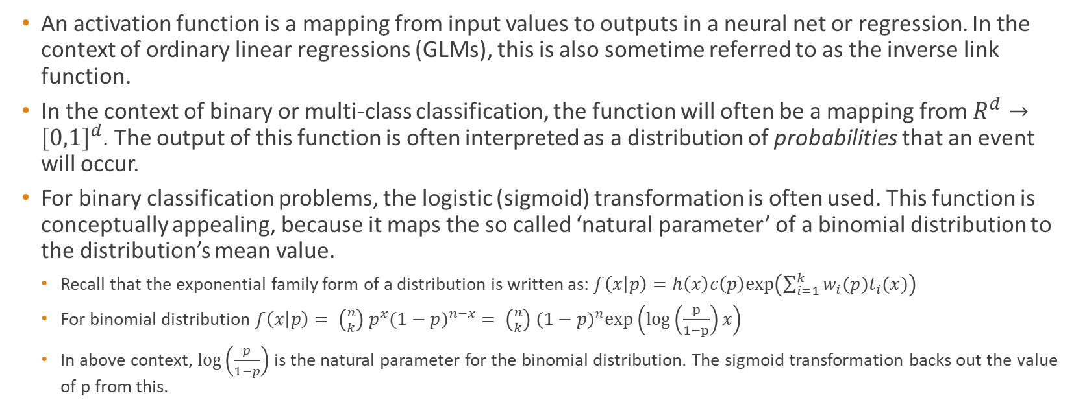
Activation functions
An activation function is a mapping from input values to outputs in a neural net or regression. In the context of ordinary linear regressions (GLMs), this is also sometime referred to as the inverse link function.
In the context of binary or multi-class classification, the function will often be a mapping from $R^{d}→{[0,1]}^{d}$. The output of this function is often interpreted as a distribution of probabilities that an event will occur.
For binary classification problems, the logistic (sigmoid) transformation is often used. This function is conceptually appealing, because it maps the so called ‘natural parameter’ of a binomial distribution to the distribution’s mean value.
Recall that the exponential family form of a distribution is written as: $f\left(x | p\right)=h\left(x\right)c\left(p\right)exp⁡\left(\sum_{i=1}^{k}{w_{i}(p)t_{i}(x)}\right)$
For binomial distribution $f\left(x | p\right)= \left({n \atop k}\right) p^{x}{(1−p)}^{n−x} = \left({n \atop k}\right) {(1−p)}^{n}exp⁡\left(log\left(\frac{p}{1−p}\right)x\right)$
In above context, $\log\left(\frac{p}{1−p}\right)$ is the natural parameter for the binomial distribution. The sigmoid transformation backs out the value of p from this.

Slide 4
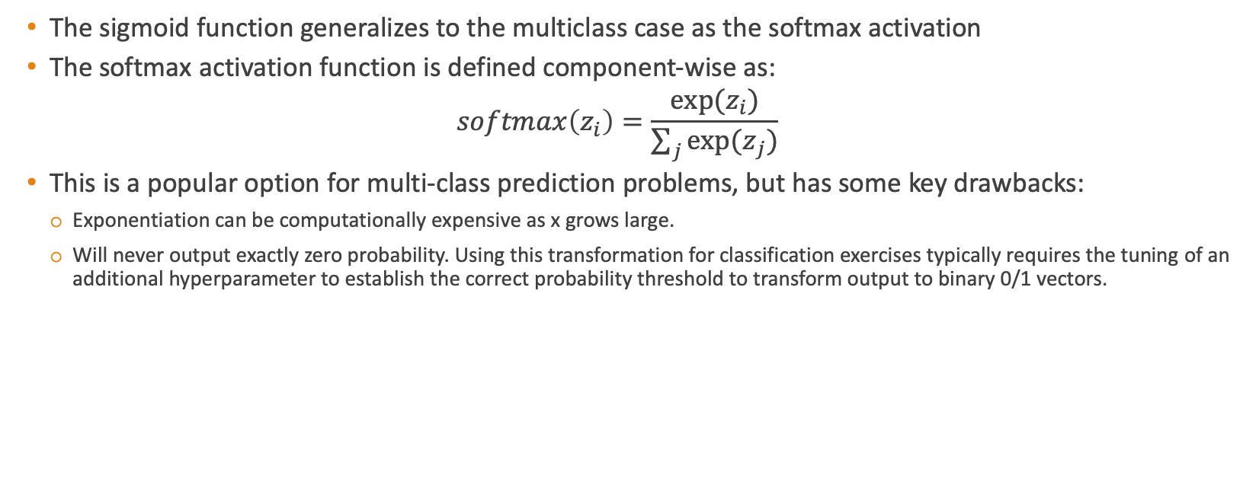
Softmax activation function
The sigmoid function generalizes to the multiclass case as the softmax activation
The softmax activation function is defined component-wise as:
$$softmax\left(z_{i}\right)=\frac{exp⁡(z_{i})}{\sum_{j}{{exp⁡(z}_{j})}}$$
This is a popular option for multi-class prediction problems, but has some key drawbacks:
Exponentiation can be computationally expensive as x grows large.
Will never output exactly zero probability. Using this transformation for classification exercises typically requires the tuning of an additional hyperparameter to establish the correct probability threshold to transform output to binary 0/1 vectors.

Slide 5
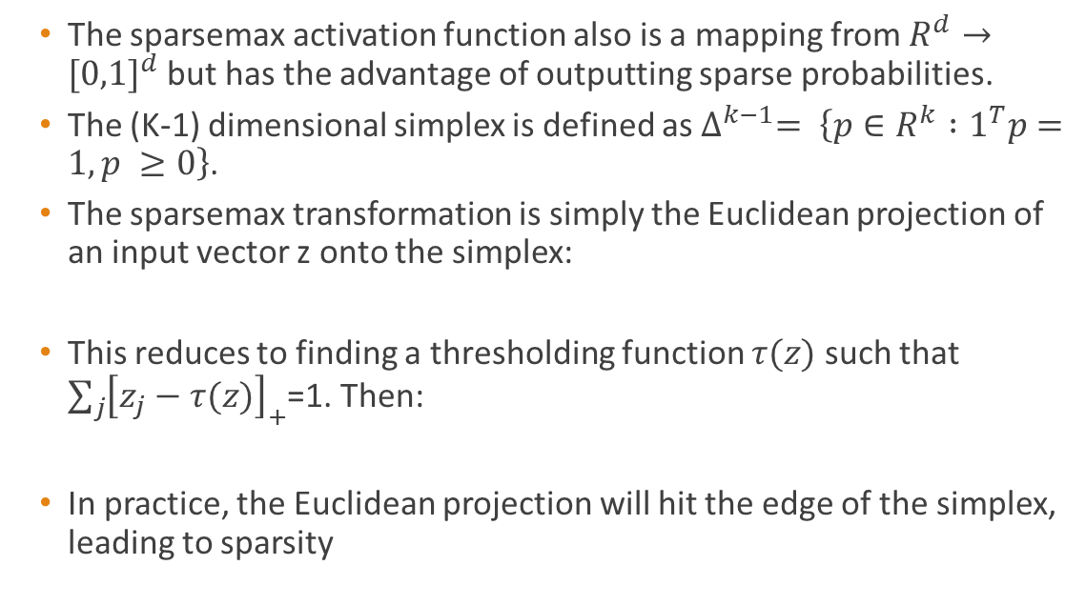

Sparsemax activation function
The sparsemax activation function also is a mapping from $R^{d}→{[0,1]}^{d}$but has the advantage of outputting sparse probabilities.
The (K-1) dimensional simplex is defined as $∆^{k−1}= \left\{p∈R^{k} :1^{T}p=1, p ≥0\right\}$.
The sparsemax transformation is simply the Euclidean projection of an input vector z onto the simplex:
This reduces to finding a thresholding function $τ(z)$ such that $\sum_{j}{{\left[z_{j}−τ(z)\right]}_{+}}$=1. Then:
In practice, the Euclidean projection will hit the edge of the simplex, leading to sparsity
$${sparsemax\left(z\right)= argmin}_{p∈∆^{k−1}}{\left\|p−z\right\|}^{2}$$
$${sparsemax}_{i}\left(z\right)={\left[z_{i}−τ(z)\right]}_{+}$$
$$p_{1}+ p_{2}≤1$$

Slide 6
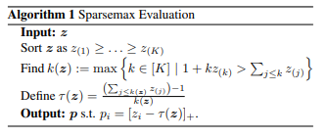
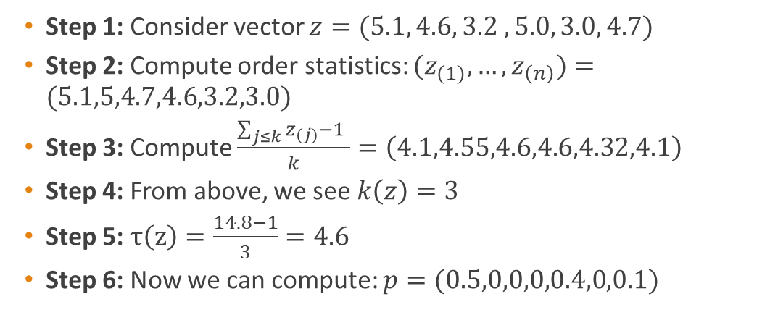
Sparsemax evaluation algorithm
Simple Illustration:
Step 1: Consider vector $z=(5.1, 4.6, 3.2 , 5.0, 3.0, 4.7)$
Step 2: Compute order statistics: ${(z}_{(1)},…,z_{\left(n\right)})=(5.1,5,4.7,4.6,3.2,3.0)$
Step 3: Compute $\frac{\sum_{j≤k}{z_{(j)}}−1 }{k}=\left(4.1,4.55,4.6,4.6,4.32,4.1\right)$
Step 4: From above, we see $k\left(z\right)=3$
Step 5: $τ\left(z\right)=\frac{14.8−1}{3}=4.6$
Step 6: Now we can compute: $p=(0.5,0,0,0,0.4,0,0.1)$

Slide 7


2 dimensional case
Sparsemax Simplification – 2D case

Slide 8
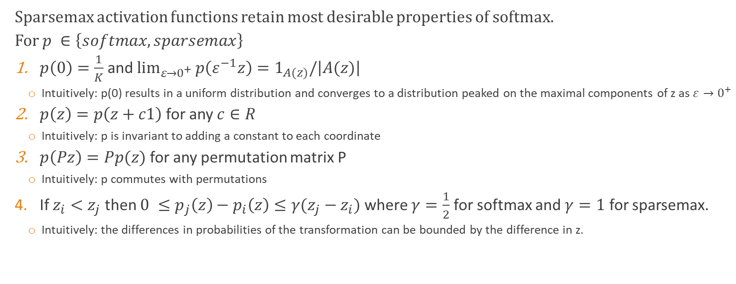
Properties of Sparsemax
Sparsemax activation functions retain most desirable properties of softmax.
For $p ∈\left\{softmax,sparsemax\right\}$
$p\left(0\right)=\frac{1}{K}$ and $\lim_{ε→0^{+}}{p\left(ε^{−1}z\right)=1_{A(z)}/\left|A(z)\right|}$
Intuitively: p(0) results in a uniform distribution and converges to a distribution peaked on the maximal components of z as $ε→0^{+}$
$p\left(z\right)=p\left(z+c1\right)$ for any $c∈R$
Intuitively: p is invariant to adding a constant to each coordinate
$p\left(Pz\right)=Pp(z)$ for any permutation matrix P
Intuitively: p commutes with permutations
If $z_{i}<z_{j}$ then $0 ≤p_{j}\left(z\right)−p_{i}\left(z\right)≤γ(z_{j}−z_{i})$ where $γ=\frac{1}{2}$ for softmax and $γ=1$ for sparsemax.
Intuitively: the differences in probabilities of the transformation can be bounded by the difference in z.

Slide 9




Loss functions, Gradients, Jacobians
 | Softmax | Sparsemax
Loss Function
Jacobian
Gradient

Slide 10
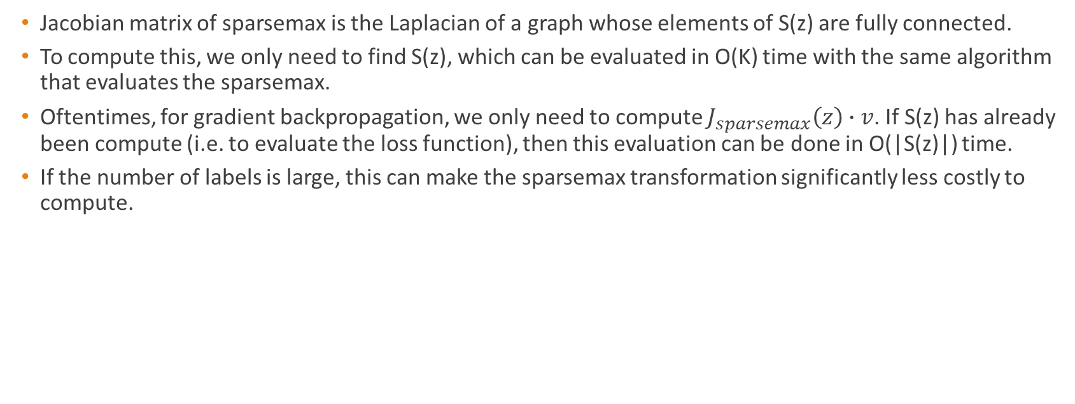
Advantages of sparsemax over softmax
Jacobian matrix of sparsemax is the Laplacian of a graph whose elements of S(z) are fully connected.
To compute this, we only need to find S(z), which can be evaluated in O(K) time with the same algorithm that evaluates the sparsemax.
Oftentimes, for gradient backpropagation, we only need to compute $J_{sparsemax}\left(z\right)∙v$. If S(z) has already been compute (i.e. to evaluate the loss function), then this evaluation can be done in O(|S(z)|) time.
If the number of labels is large, this can make the sparsemax transformation significantly less costly to compute.

Slide 11
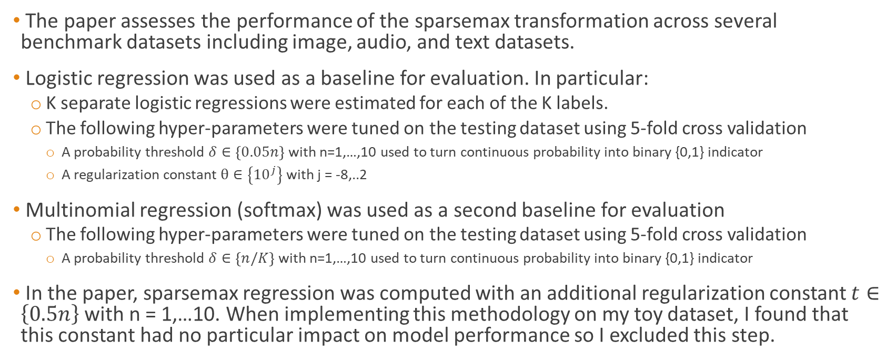
Empirical results—multilabel classification
The paper assesses the performance of the sparsemax transformation across several benchmark datasets including image, audio, and text datasets.
Logistic regression was used as a baseline for evaluation. In particular:
K separate logistic regressions were estimated for each of the K labels.
The following hyper-parameters were tuned on the testing dataset using 5-fold cross validation
A probability threshold $δ∈\left\{0.05n\right\}$ with n=1,…,10 used to turn continuous probability into binary {0,1} indicator
A regularization constant $θ∈\left\{{10}^{j}\right\}$ with j = -8,..2
Multinomial regression (softmax) was used as a second baseline for evaluation
The following hyper-parameters were tuned on the testing dataset using 5-fold cross validation
A probability threshold $δ∈\left\{n/K\right\}$ with n=1,…,10 used to turn continuous probability into binary {0,1} indicator
In the paper, sparsemax regression was computed with an additional regularization constant $t∈\left\{0.5n\right\}$ with n = 1,…10. When implementing this methodology on my toy dataset, I found that this constant had no particular impact on model performance so I excluded this step.

Slide 12
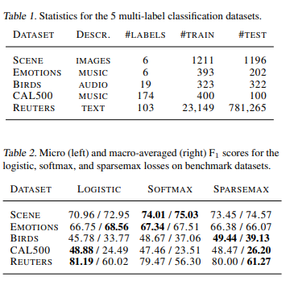
Empirical results—multilabel classification
Performance was relatively comparable across datasets for each methodology, although sparsemax seemed to have a slight advantage for datasets with large numbers of labels.
Overall take-away:
Sparsemax seems to be a reasonable transformation to apply, especially for cases where sparsity is desirable. However, it’s not a “slam dunk” relative to existing transformations
Has the advantage of not needing to tune an additional hyperparameter for the probability threshold in classification problems.
In certain cases involving heavy computation, may be faster to minimize Sparsemax over Softmax loss function.

